Slide 1
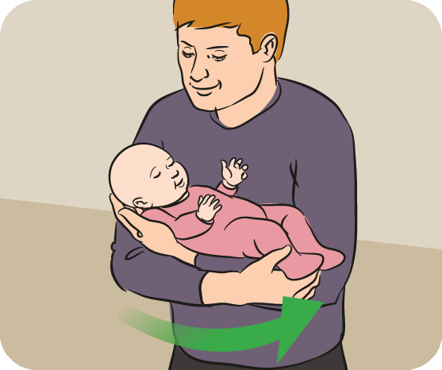
Earth Steward Pledge
I pledge
To care about the world around me
To investigate and explore the world around me
To share my learning and do service
To make the world around me a better place for plants, animals, and people
I carry this commitment with me always
I am an Earth Steward!

